Slide 1


"The polling industry blows it again"
Schwartz reporting on
Steven Shepard reporting on
FiveThirtyEight et al.
Notes:
A lot has transpired since the election, but before the presidential election was called, already there were some grumblings about the polling election predictions.
Here's one title from poltico.com
In the wake of how close the presidential election initially appeared to be.

Slide 2
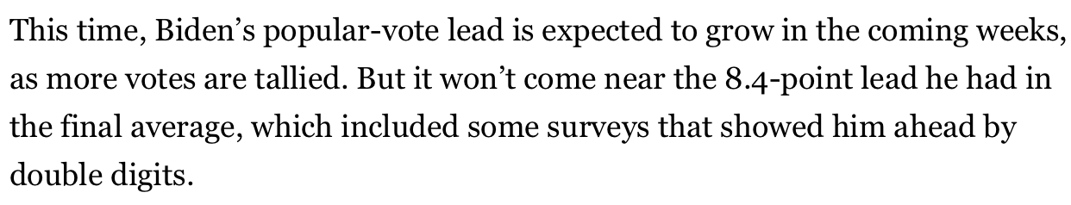
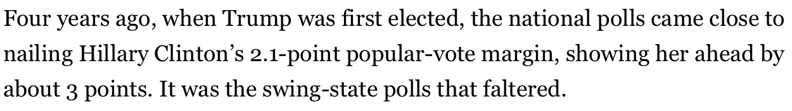
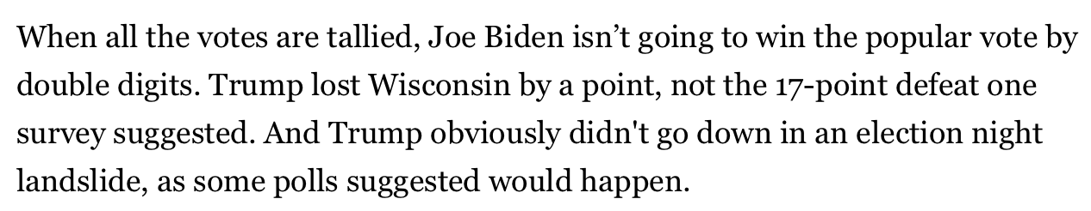
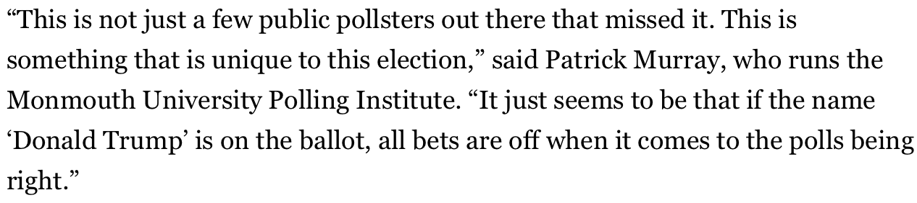
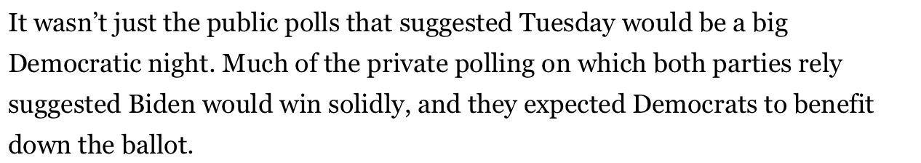
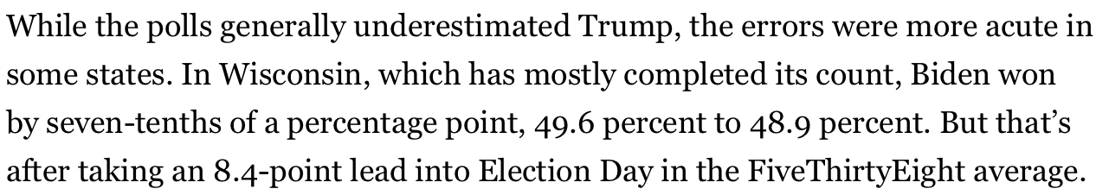
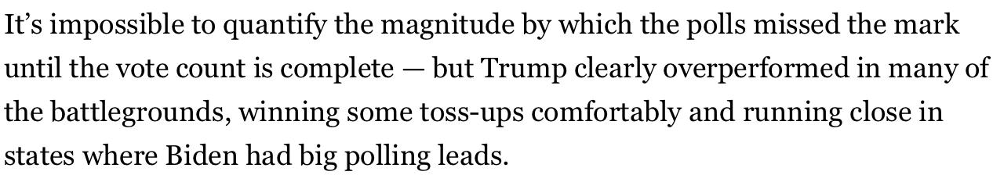
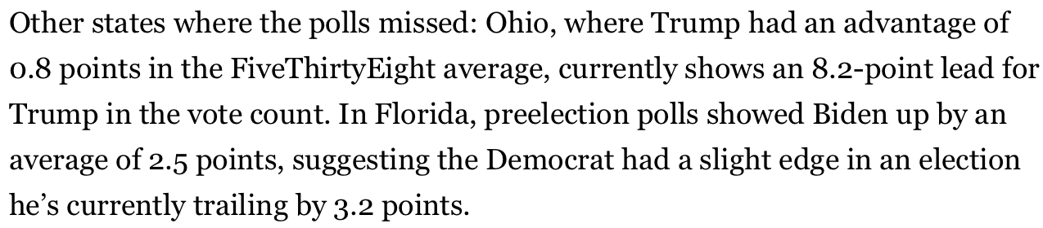
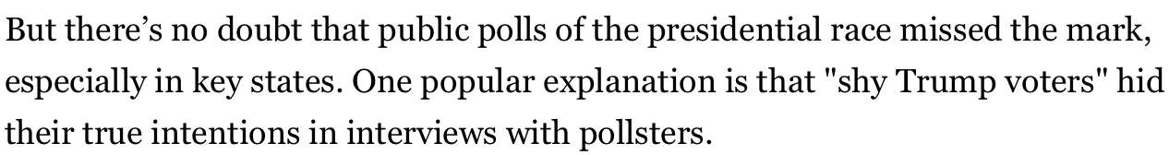
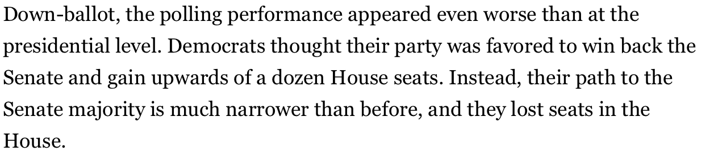
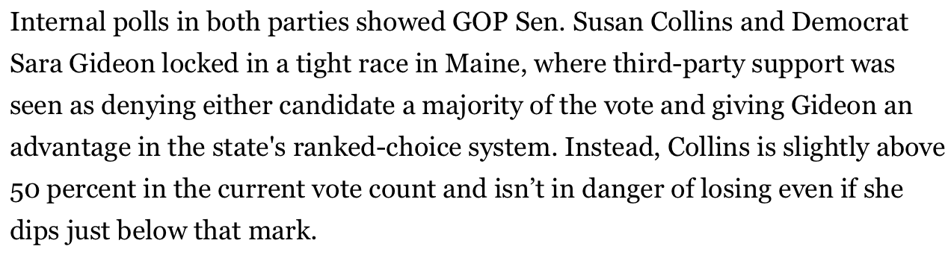
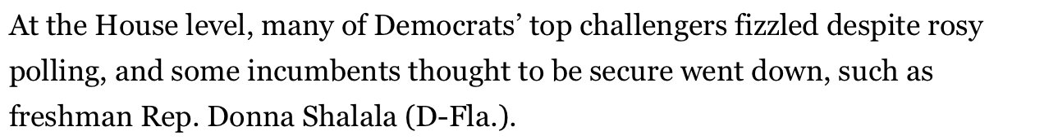
No Specific Citations
2+
2+
2+
1+
1+
2+
9+
2+
# of times "Polls" were referred to without any actual identification
3+
2+
4+
2+
2+
Notes:
Here I did some counting – not super carefully – these are just screen shots -- the number of times that polls abstractly were referred to without identification;
The effect of this was seemingly to produce an overgeneralization of all polling as a single uniform entity.
These "polls" are stated as bad, but I don't have any way to validate -- confirm or contradict – the statement that the "polls" were not good.
Perhaps this is just the sort of article that doesn't cite sources?

Slide 3
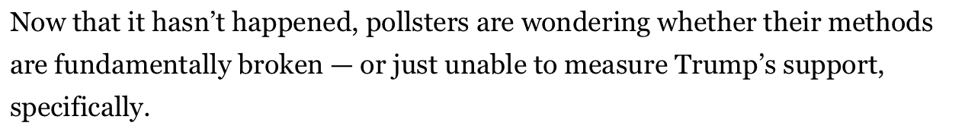
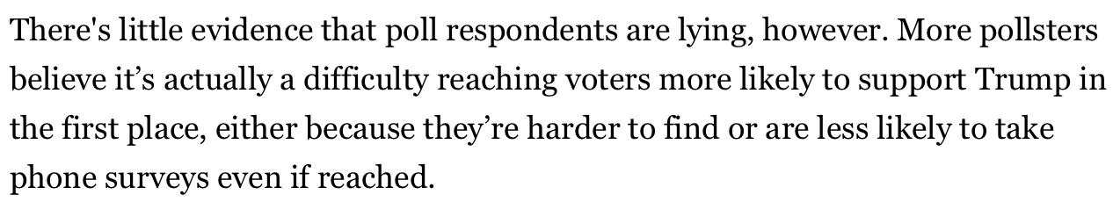
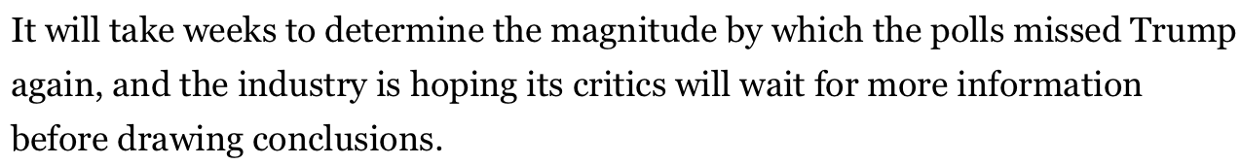
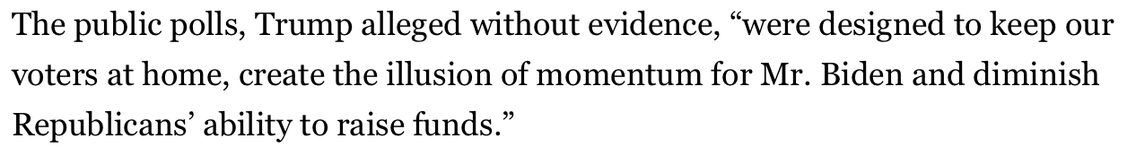
Hmm...
# of strange non-specific and non-referenced claims made
# of times "Pollsters" were referred to generically without identification
6+
2
2
1
# of times others were criticized for failing to provide evidence
1
Notes:
Top Left: just the same as the previous page... really overgeneralizing a diverse group of people into a single homogenous entity...
Bot Left: that's pretty rich... given how unwilling this article is to give us evidence... just claiming you've looked at evidence is not enough...
Top Right:
1. [seems to be stating that political bias is not a thing] non partisan media/academic pollsters? What? Since when do these entities not have political leanings?
- I expect some partisan outlets claim to be non-partisan... so which is which?
- does this mean we should expect partisan outlets to be biased?
2. [confuses the term "Methods" with the term "Assumptions"]Methods? Or, assumptions of methods... is what you mean
3. [oh that's rich again...like exactly what happened in this article...]
4. I don't think this is unique to this election... I remember 2016 also being a huge surprise
5. [I just need to see what specific poll we're talking about... all feel this way?]
6. [I just need to see what specific poll we're talking about... all failed to do this? additionally, after the fact, it seems like the numbers panned out, no?]
After looking at this you can see that I'm beginning to get biased against this article... I'm starting to find fault with everything

Slide 4
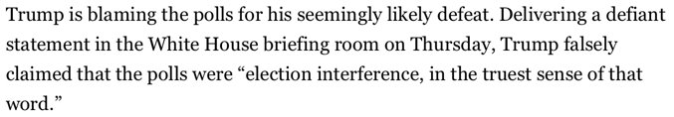
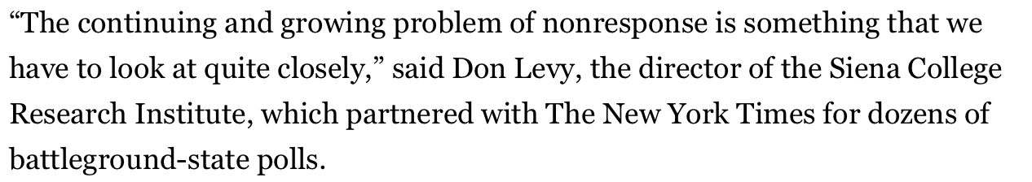
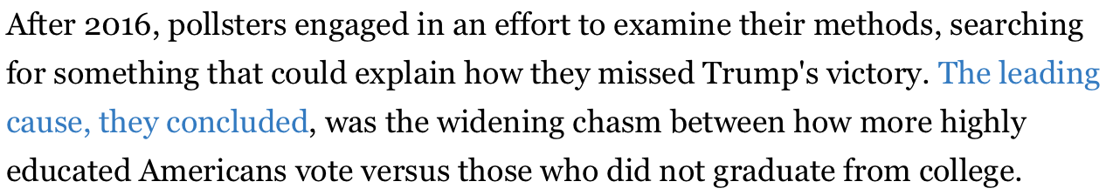
Actual Reporting Provided in this Article
Patrick Murry, Monmouth Polling
Donald Trump
Don Levy, Sienna College
"Pollsters" (AAPOR, Kennedy et al.)

Slide 5
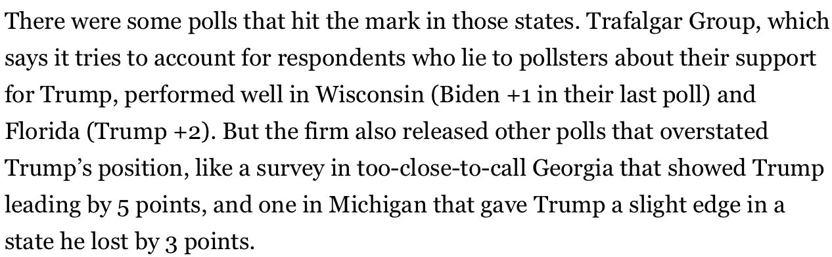
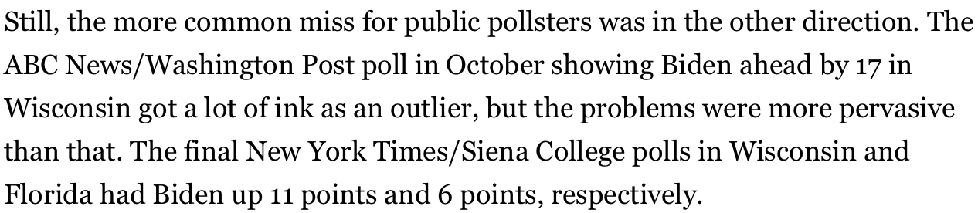
Actual Polls Reported On in this Article
FiveThirtyEight: Wisconsin
Trafalgar Group
ABC News/Washington Post New York Times/Siena College
Notes:
So these are the examples of "bad polls", seemingly on which the who polling effort is rule as being broken.
Let's take a look at these...

Slide 6
Actual Polls Reported On in this Article
FiveThirtyEight: Ohio
Trafalgar Group
ABC News/Washington Post New York Times/Siena College
Notes:
So these are the examples of "bad polls", seemingly on which the who polling effort is rule as being broken.
Let's take a look at these...

Slide 7
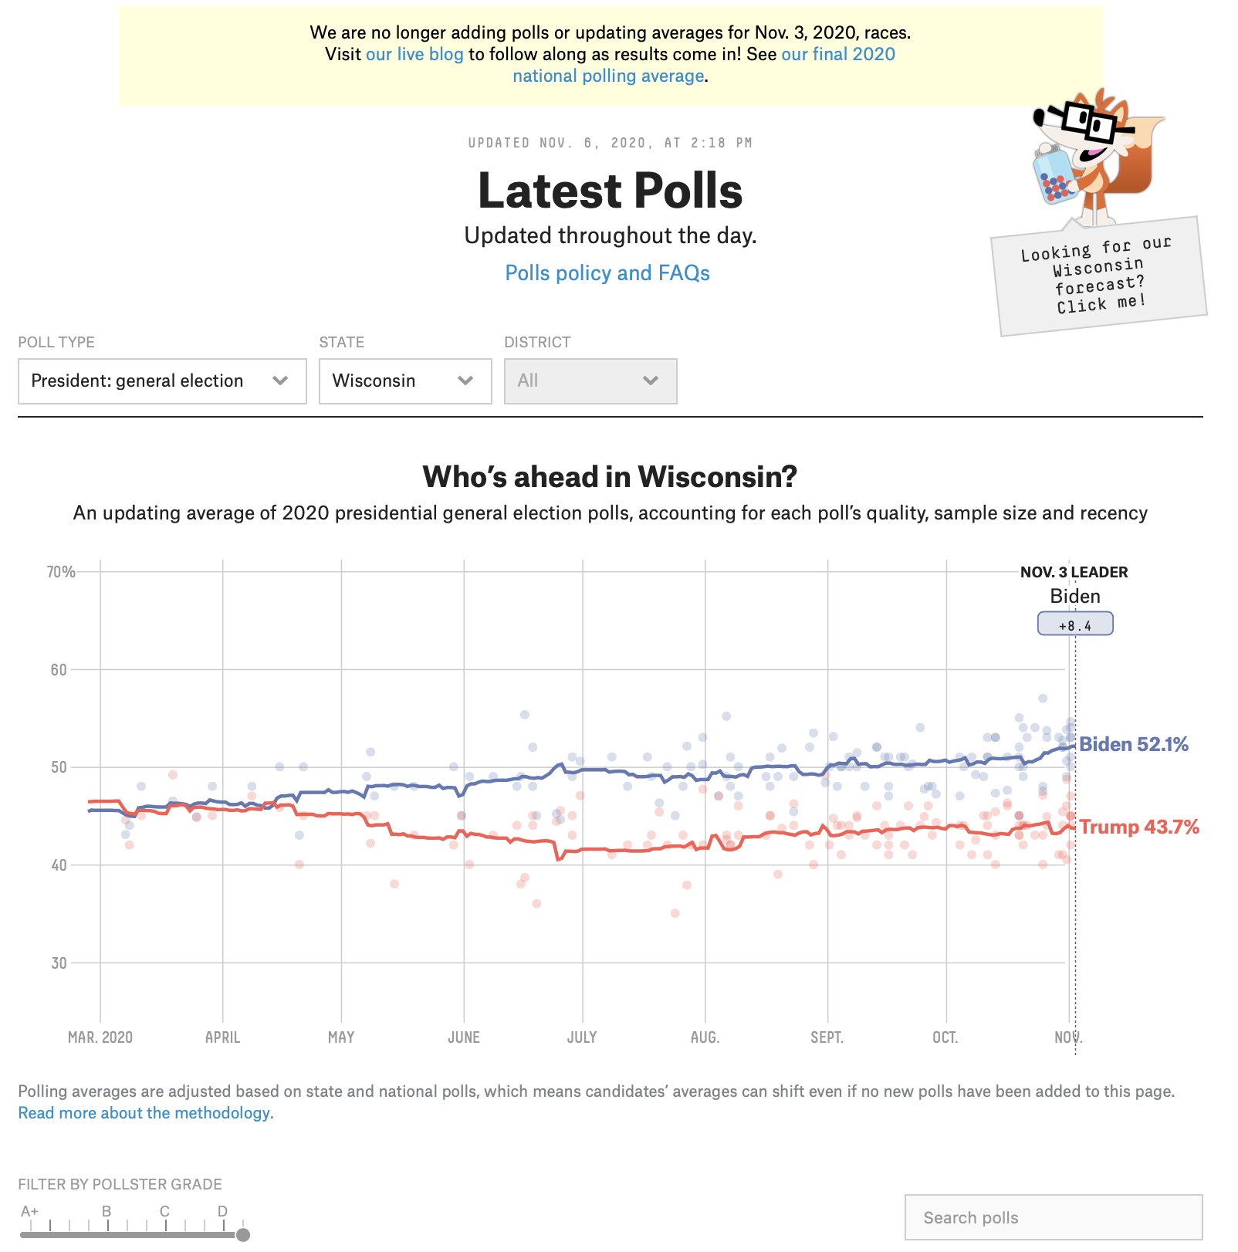
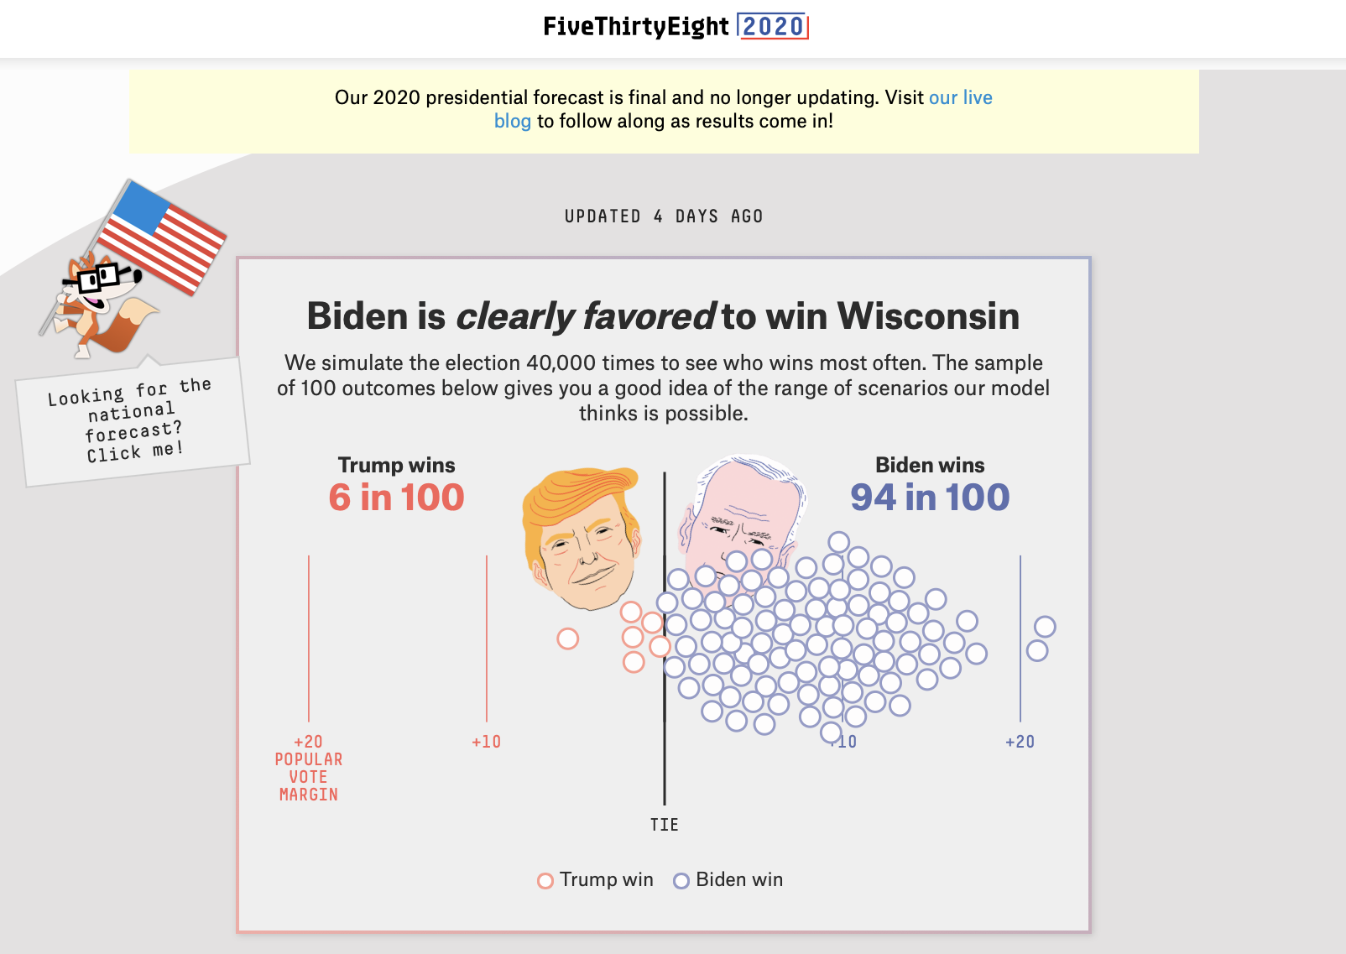
FiveThirtyEight: Wisconsin
Notes:
They are complaining that this poll got it wrong: There's nothing to whine about here
First: statistically speaking, this is not enough to reject the idea that Trump could win, under standard (0.05) statistical evidence measures
Second: (which is an identical statement from a statistical perspective, 0 or 49.6%-48.9% is within the 95% confidence interval.
https://www.realclearpolitics.com/elections/live_results/2020/state/wi/president/

Slide 8
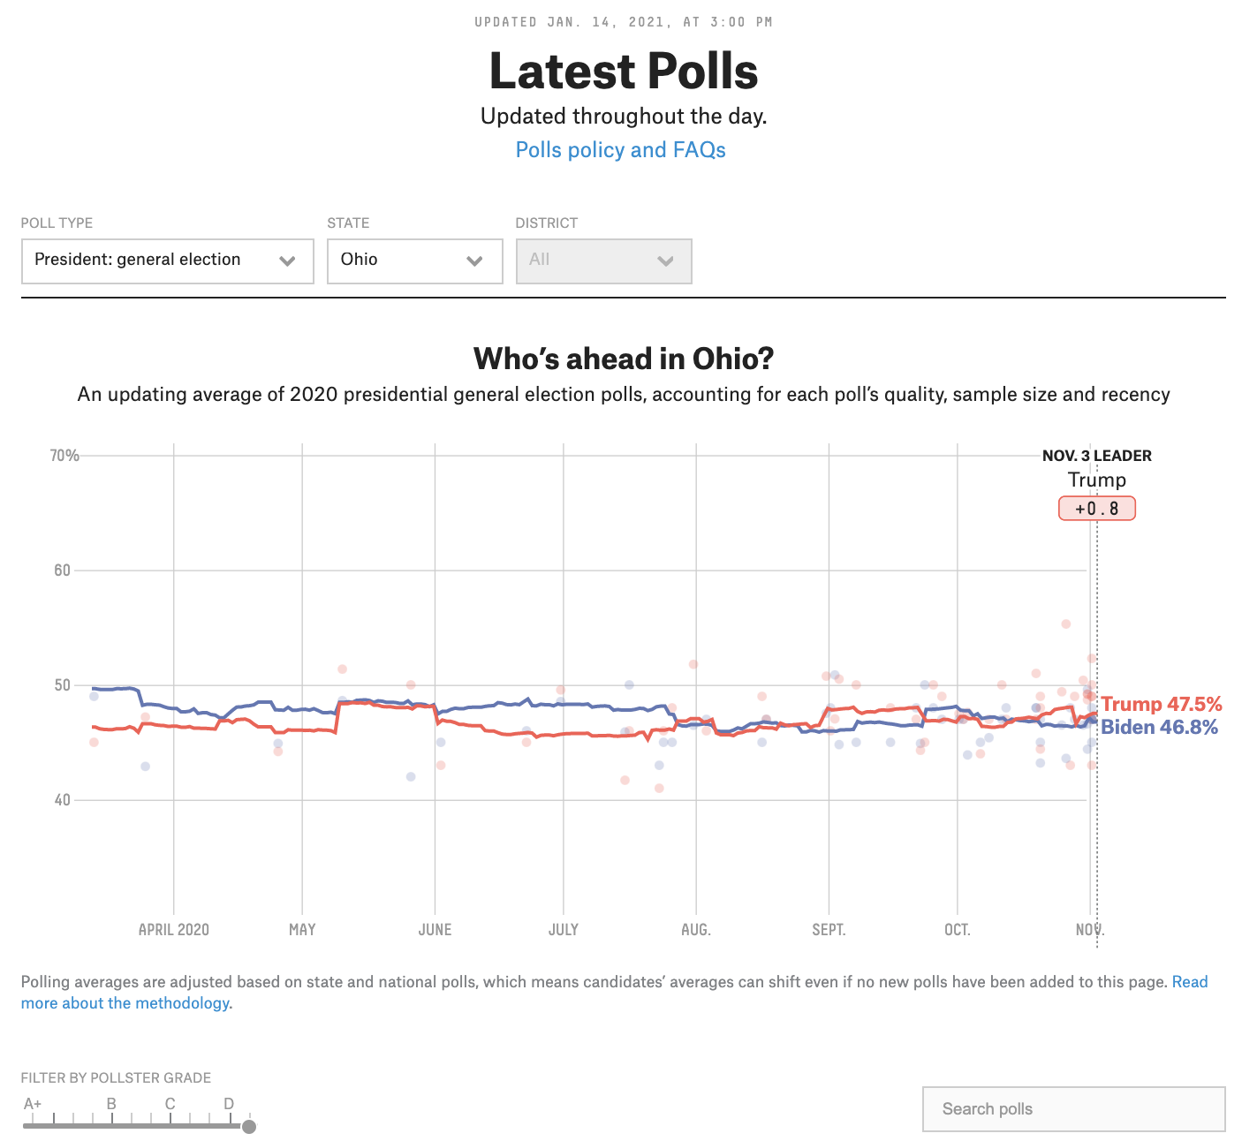
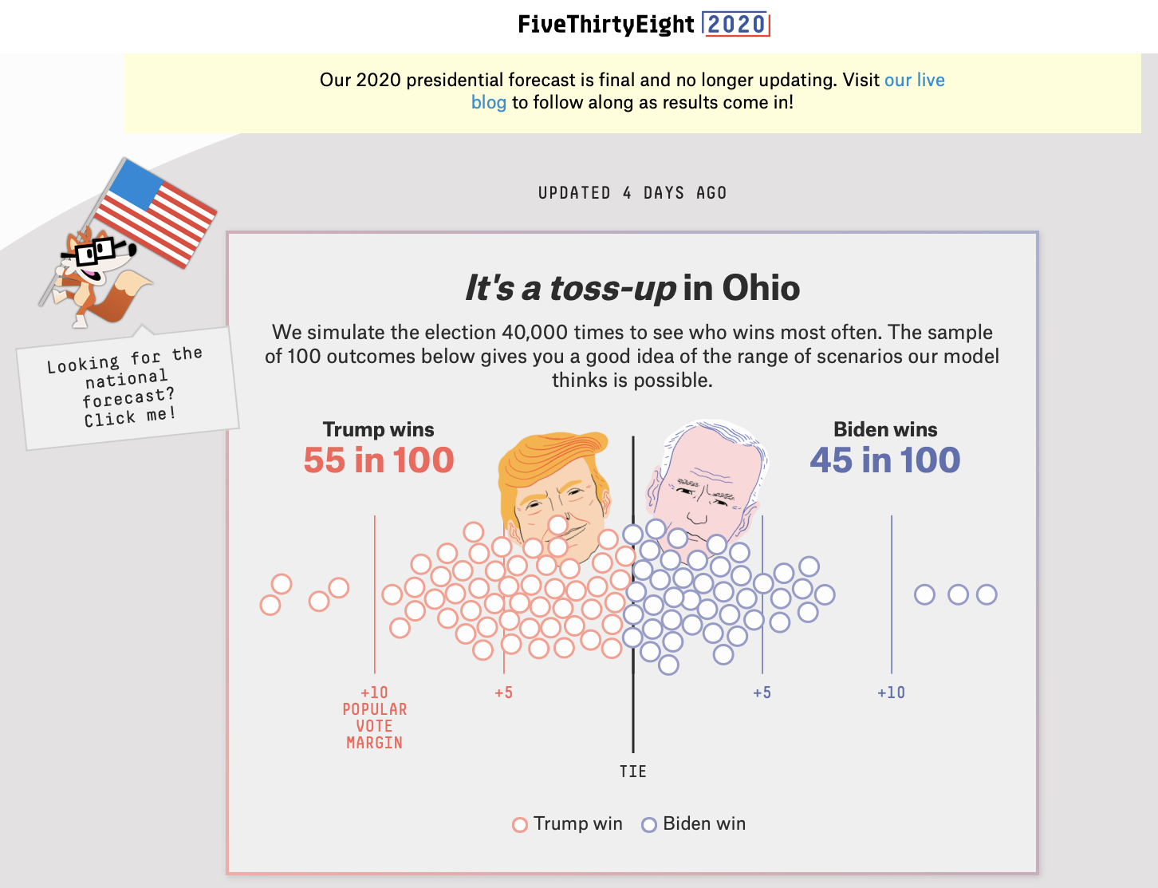
FiveThirtyEight: Ohio
Notes:
Nothing to complain about here... there is not a strong call to be had

Slide 9
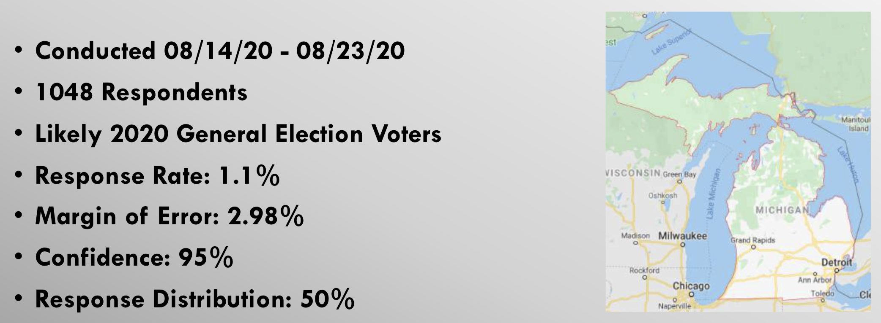
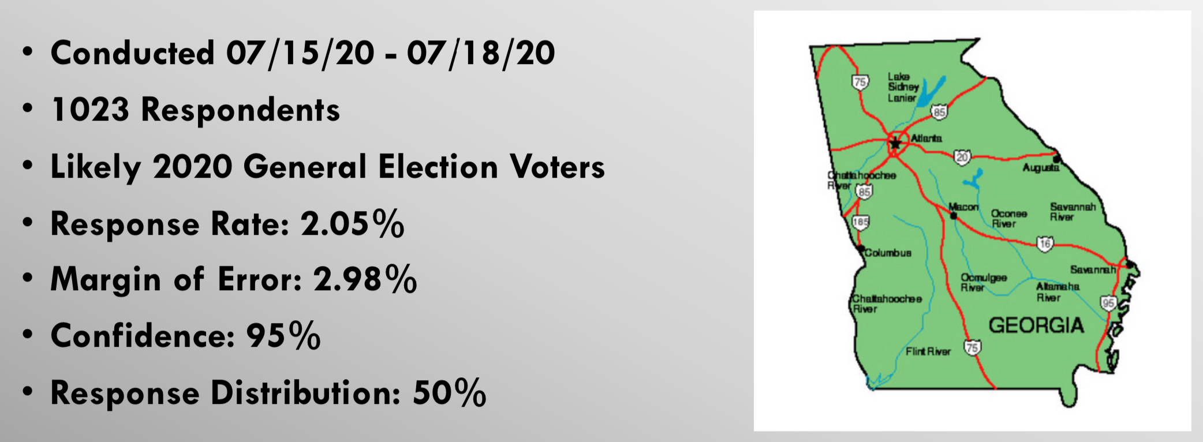
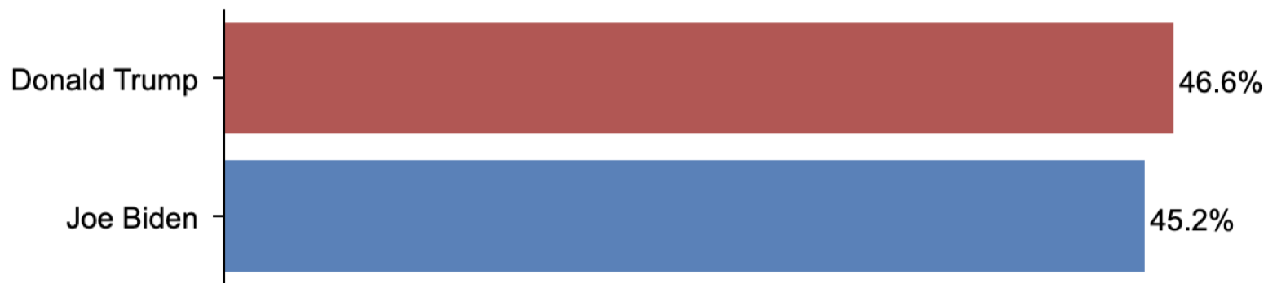
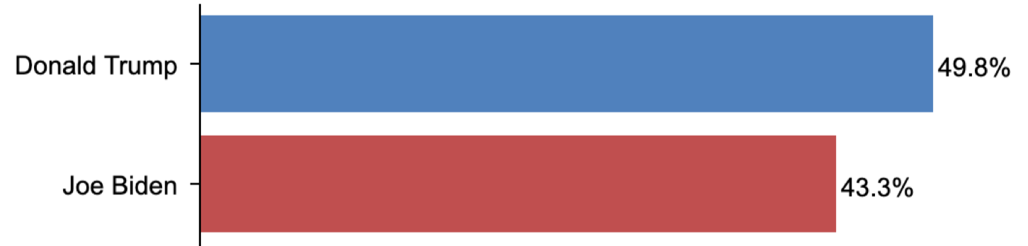
FiveThirtyEight: Wisconsin
Trafalgar Group
Notes:
Let's look at the Trafalgar Group:
- NOPE: Same story with Michigan as with the WI poll – this is too close to call
- GA: this is the first poll they're showing me that's indeed wrong/bad...
https://www.realclearpolitics.com/elections/live_results/2020/state/ga/president/

Slide 10
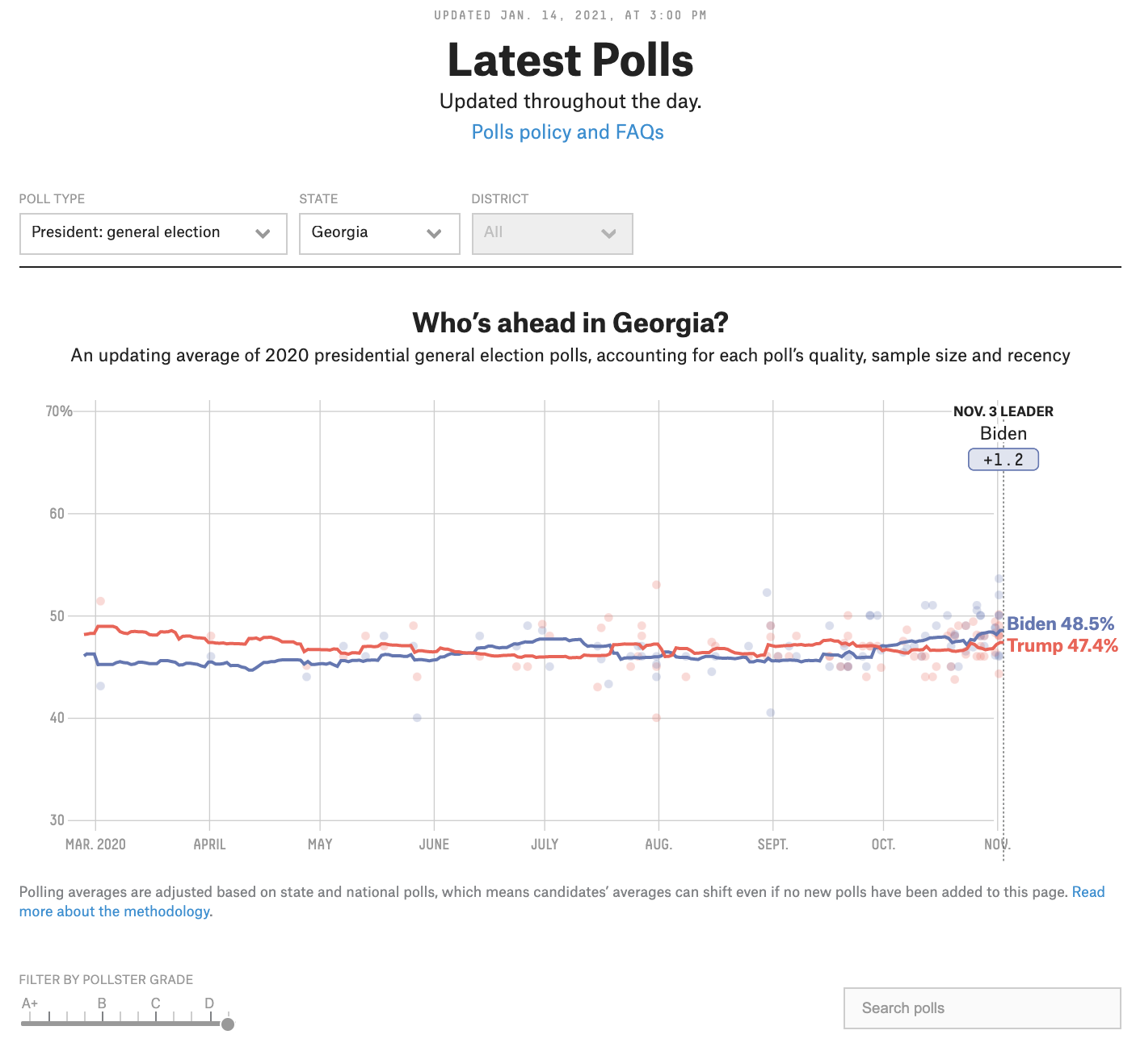
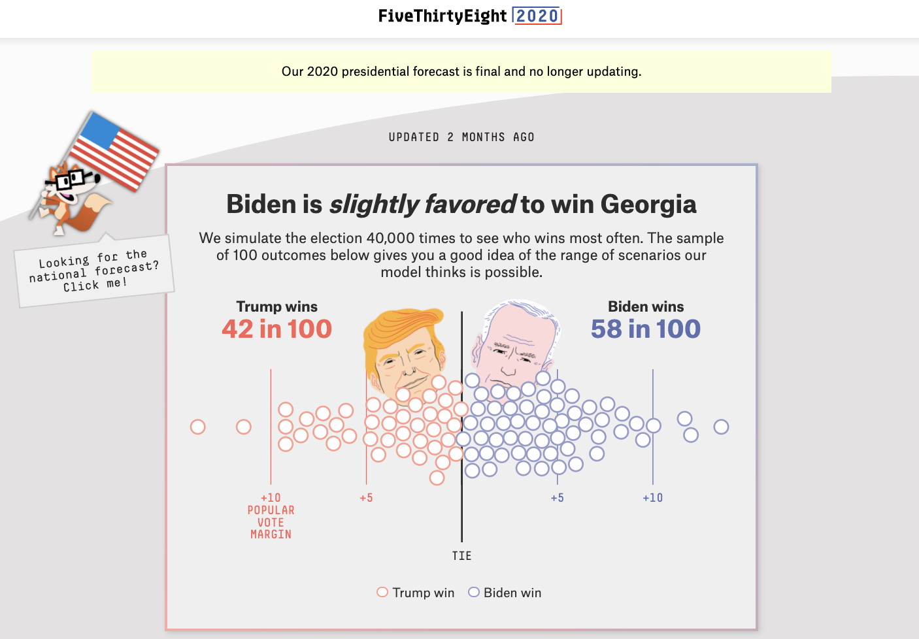
FiveThirtyEight: Wisconsin
Trafalgar Group (is this representative?)
Notes:
But is this representative of polling in general?
They are complaining that this poll got it wrong: There's nothing to whine about here
First: statistically speaking, this is not enough to reject the idea that Trump could win, under standard (0.05) statistical evidence measures
Second: (which is an identical statement from a statistical perspective, 0 or 49.6%-48.9% is within the 95% confidence interval.
https://www.realclearpolitics.com/elections/live_results/2020/state/wi/president/

Slide 11
FiveThirtyEight: Wisconsin
Trafalgar Group
ABC/The Post + The Times/Sienna
...
Notes:
Here's the 3rd set of referenced polls:
- they were polls that were presumably quite bad
- they even have the director of the group that produced one of the polls saying that the polls are bad!
Anway...
Are these representative of polling efforts, generally?
1. Wisconsin... we've already talked about... the call doesn't have traditionally accepted statistical power
Florida... okay, let's look at that

Slide 12
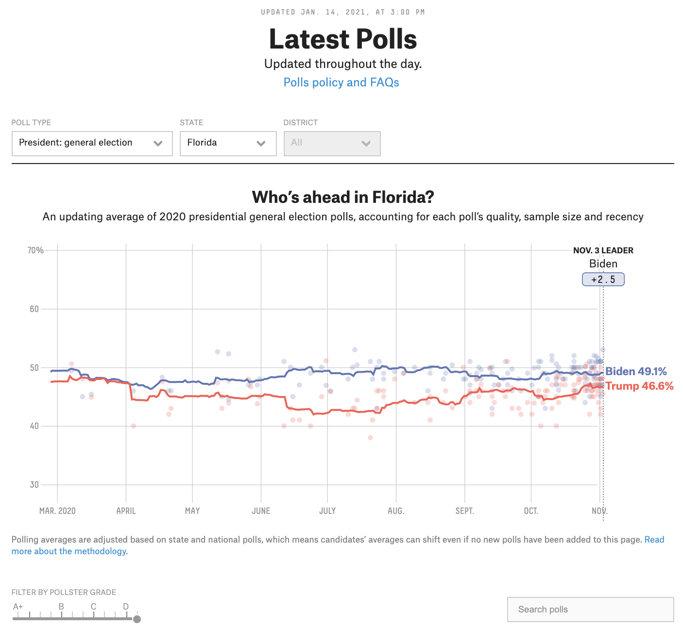
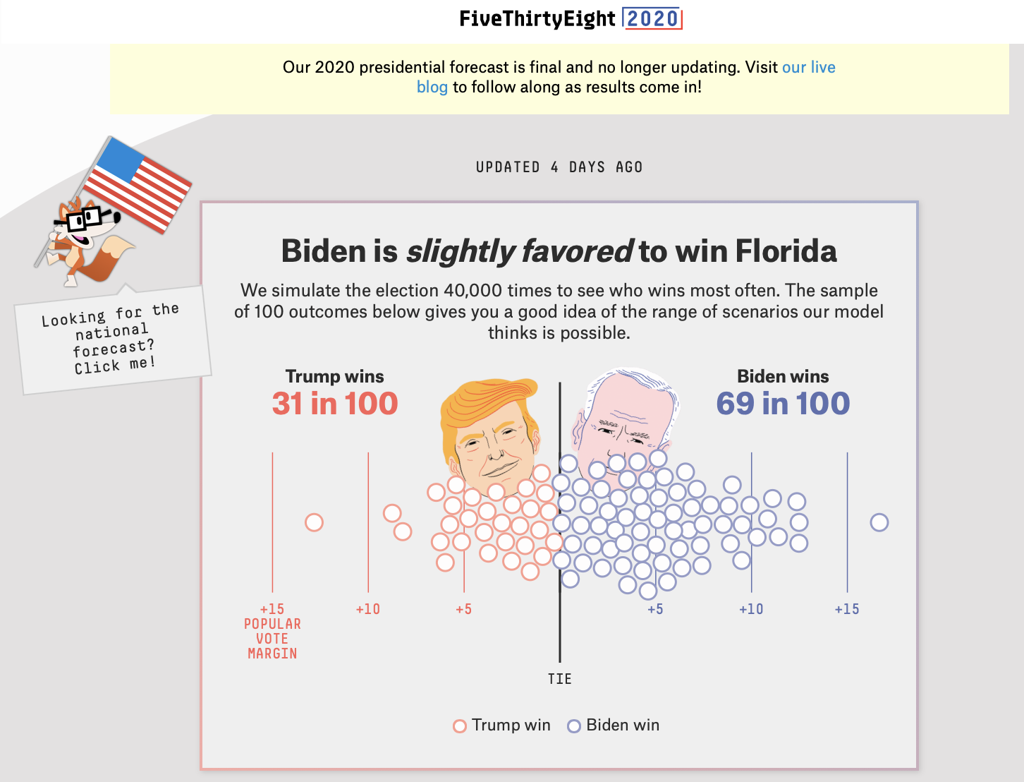
FiveThirtyEight: Wisconsin
Trafalgar Group
ABC/The Post + The Times/Sienna
Notes:
Reported numbers are not representative...

Slide 13
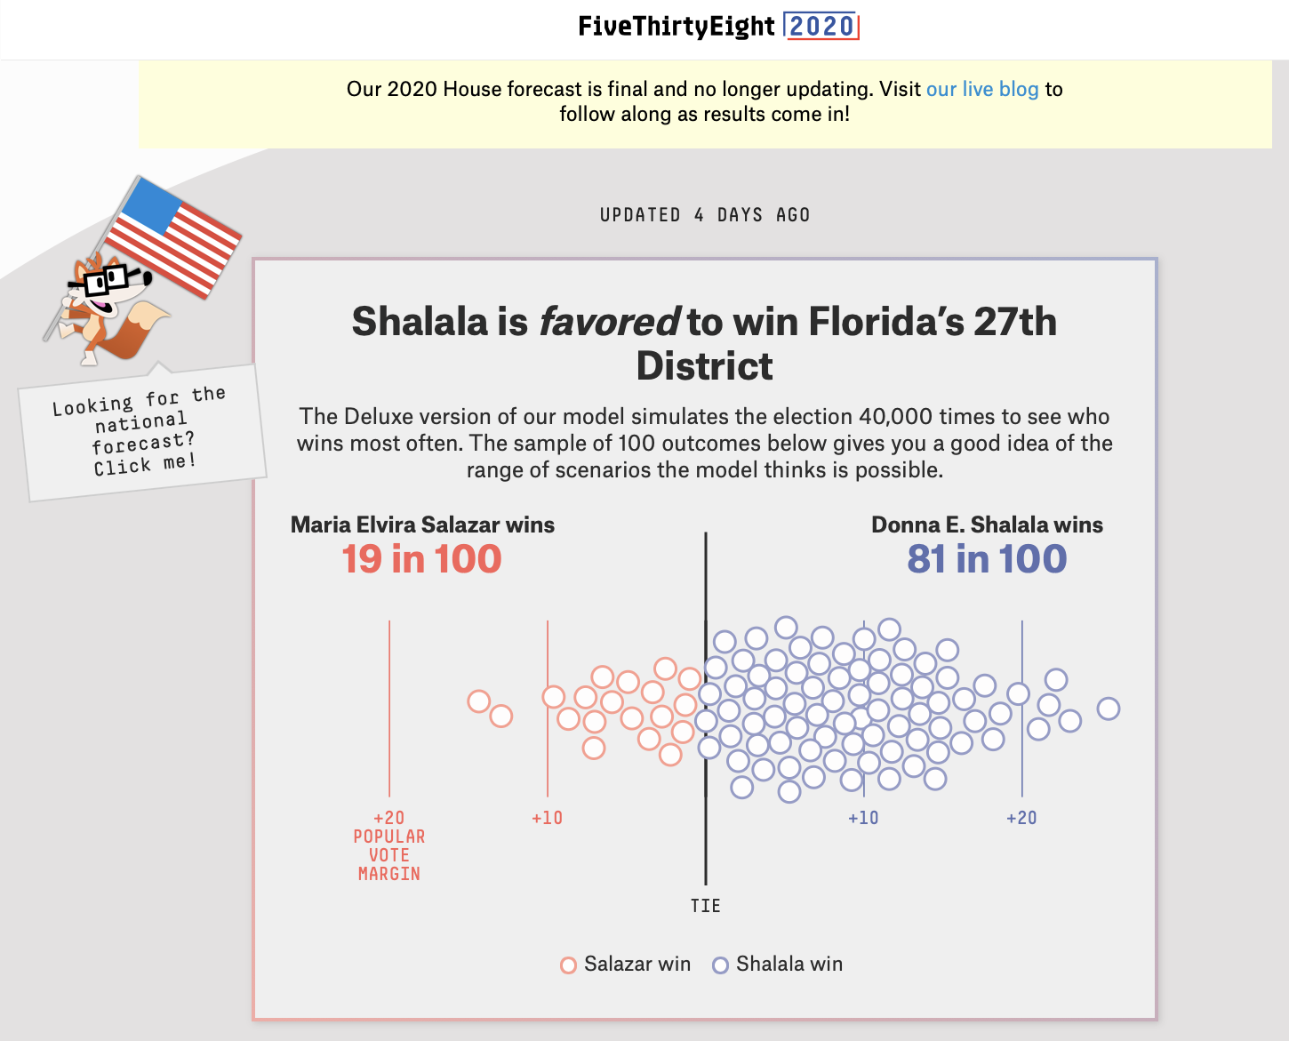
More...

Slide 14
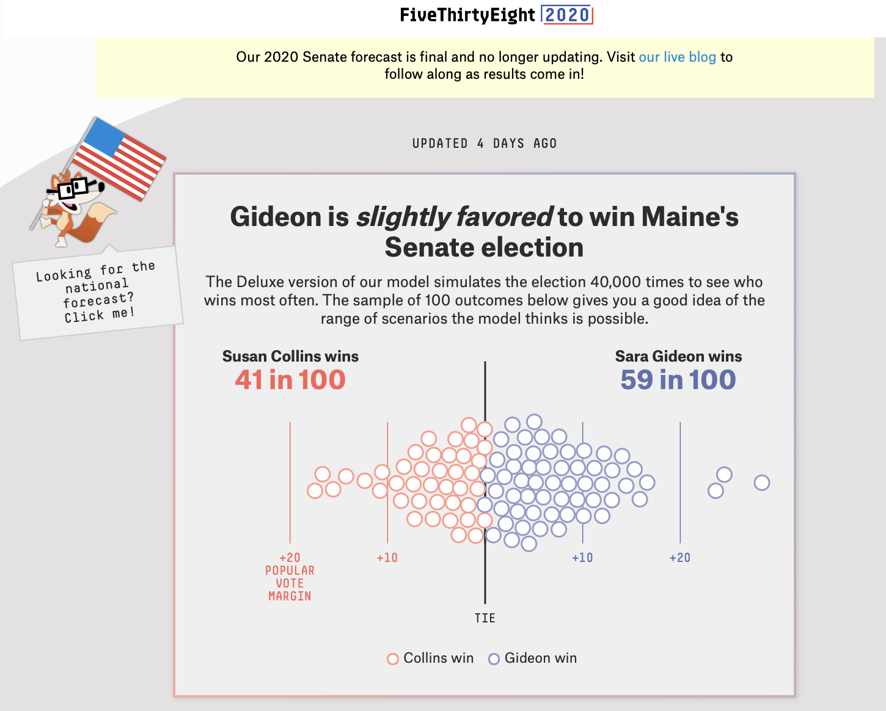
More...

Slide 15

Actually Interesting Reporting
"Shy Trump Voters"
Non-Representative Surveys
Surveys Non-Response Bias
"Education Chasm"
Notes:
Basically my view at this point is that their "blanket" negative reporting on polling has COMPLETELY MISSED THE BOAT
- but they do have a few interesting things that they've reported on:

Slide 16
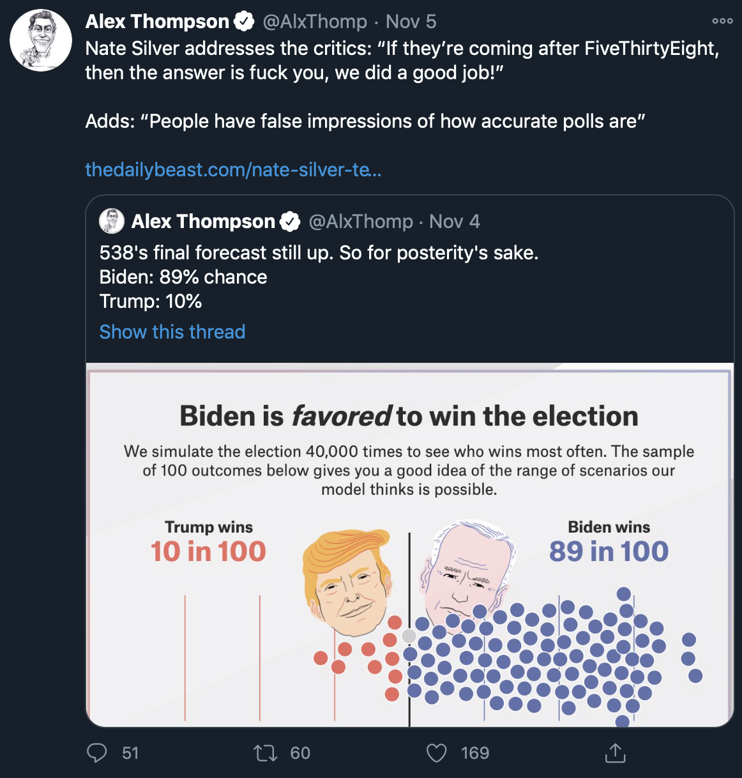
https://twitter.com/AlxThomp/status/1324362168121307140

Slide 17
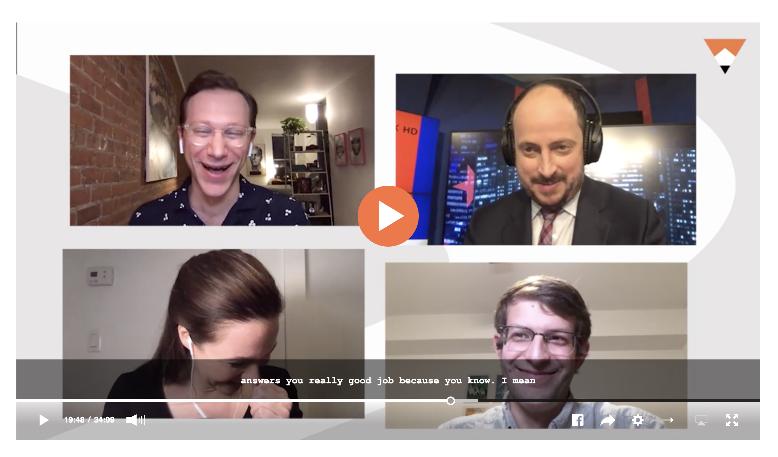
"If they're coming after FiveThirtyEight then the answer is <BLANK> you -- we did a good job"
19:45 -->
https://fivethirtyeight.com/videos/when-will-we-finally-get-results-in-unprojected-states/

Slide 18
Conclusions/Takeaways/My Opinion
Article raises 4 interesting points worth considering
Has a handful of examples of "bad" polls
a majority of which are mischaracterized as such because The article seems to not understand uncertainty
[Nonetheless upon which] It seems to totally overgeneralize from

Slide 19
Conclusions/Takeaways/My Opinion
"The polling industry blows it again"?
Nope.
"Data illiteracy blows it again..."

